Slide 1

StartupLens
An exploration of the Indian startup funding ecosystem
Vignesh S
PGA 26

Slide 2

Understanding the Indian Startup Ecosystem
Challenges and Gaps
Startup Ecosystem
Data Gaps
Regional Inequality
Round Clarity

Slide 3

Project Overview
Objective
Startup Insights: Analyze funding patterns, investor participation, and sector trends.
Data-Driven Decisions: Empower stakeholders with insights on industry performance and investment behavior.
Easy Access: Simplify data through interactive dashboards for effortless exploration.
Trend Tracking: Identify emerging sectors, geographic patterns, and funding evolution.
Strategic Guidance: Provide actionable insights for investors and business leaders.

Slide 4
Investments
Cumulative funding across the years reflects market confidence.
Investors
Unique investors indicate a diverse investment landscape.
Measuring What Matters:
Key Metrics
Companies
Startups receiving funding showcase a vibrant startup ecosystem.
Rounds
Funding rounds by amount and frequency highlight investment trends.
Regional Distribution
States reveal investment hotspots critical for strategic focus.
Industries
Investment growth by round and region suggests evolving market dynamics.

Slide 5

Key Performance Indicators (KPIs)

Slide 6
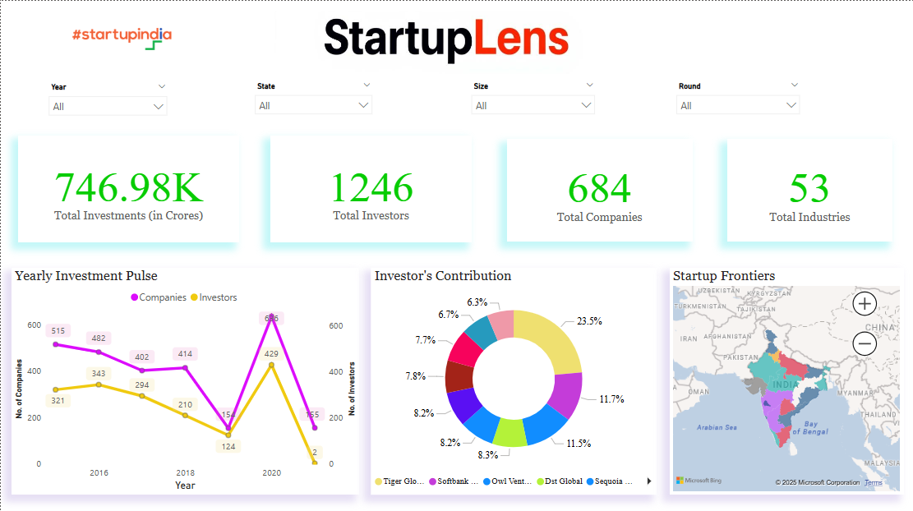
Dashboard : Page 1

Slide 7
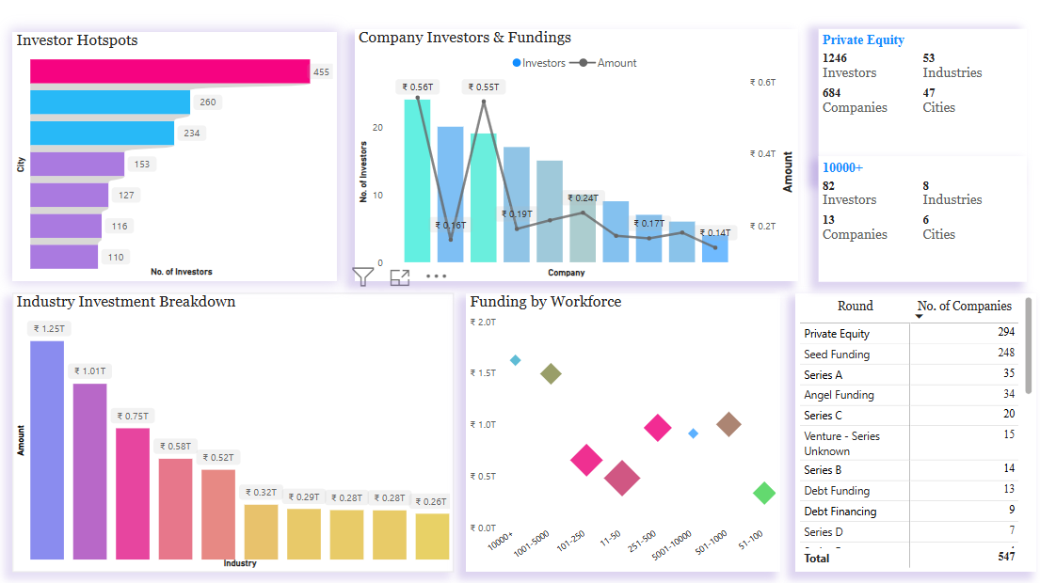
Dashboard : Page 2

Slide 8

Key Insights from Startup Ecosystem
Understanding the Current Investment Landscape
Dominance of E-Commerce, EdTech and FinTech
Stabilization of EdTech
Emerging Hubs on the Rise
Global Investor Participation
Geographical Investment Distribution
Bangalore leads with 47% of investments, followed by Mumbai at 13.7% and Gurugram at 13%.
E-Commerce, EdTech and FinTech sectors dominate the investment landscape, accounting for approximately 40% of total funding.
Hyderabad and Noida are emerging as significant investment hubs, showing growth year-on-year
Notable decrease in global investor participation, especially post covid period.
Post-2020, EdTech saw a significant surge in funding but is currently stabilizing, indicating market maturation.

Slide 9
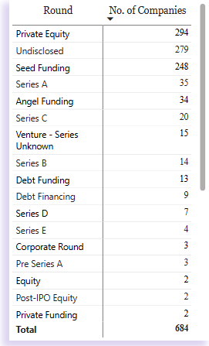
In-Depth Analysis of Funding Rounds
Visualizing Trends and Insights in Funding
Private Equity Leads: It accounts for 53.8% of disclosed funding, making it the most preferred funding type.
Early-Stage Focus: Seed Funding (248) and Series A (35) together represent 51.7%, showing a strong focus on early-stage investments.
Undisclosed Dominance: A significant portion of funding rounds remains undisclosed, indicating confidential high-value deals and strategic investments.
Debt on the Rise: Debt Funding and Debt Financing combined account for 22 companies, reflecting growing diversification in funding approaches.
Limited Late-Stage: Series B and beyond make up less than 10%, suggesting fewer mature startups reaching advanced stages.
Niche Rounds Exist: Corporate, Equity, and Post-IPO rounds remain rare, with only a handful of companies in each category.

Slide 10

Strategic Insights for Business Growth
Key Strategies for Investors, Startups and Policymakers
Investor’s Focus Areas
Emerging Market Monitoring
Funding Strategies for Startups
Analyzing Series Trends
Encouraging Diverse Funding
1
2
3
4
5

Slide 11
Future Enhancements for StartupLens
Innovative strategies for data-driven growth
Deeper Segmentation
Advanced predictive Analysis
Real-Time Data Refresh
Custom Dashboards

Slide 12


Slide 13

Thank You
Thank You
Excited to continue refining StartupLens to drive better investment decisions and market insights.

